Slide 1


Slide 2

Death of Nadab and abihu
September 12, 2021
Golden Text
“Serve the Lord with fear, and rejoice with trembling”
Psalm 2:11

Slide 3
What do you think. . .
In what way(s) is God a “consuming fire”?
Hebrews 12:29; Leviticus 10:2

Slide 4
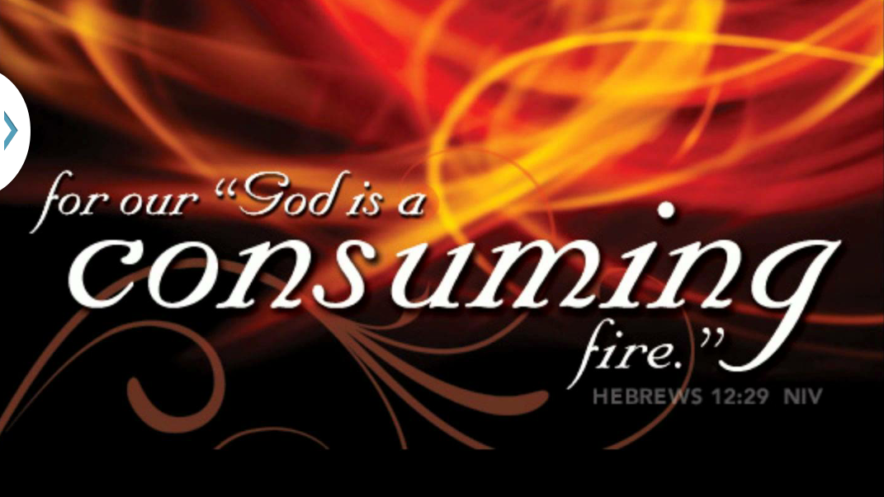

Slide 5
FACT
The negative example of Aaron’s sons
PRINCIPLE
Numerous potential consequences of disregarding God’s holiness and failing to obey His commands
APPLICATION
Ensure that our personal holiness aligns with Scripture

Slide 6

What was unacceptable about the fire that the two sons of Aaron brought before the Lord?
What did Moses tell Aaron after the death of his two sons?
How did Aaron respond to Moses’ words?

Slide 7
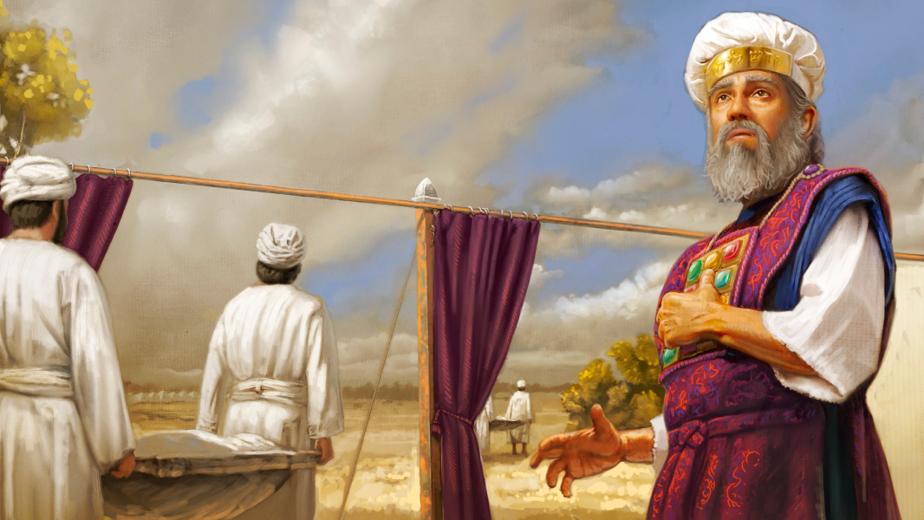
How does God’s wrath affect others?

Slide 8
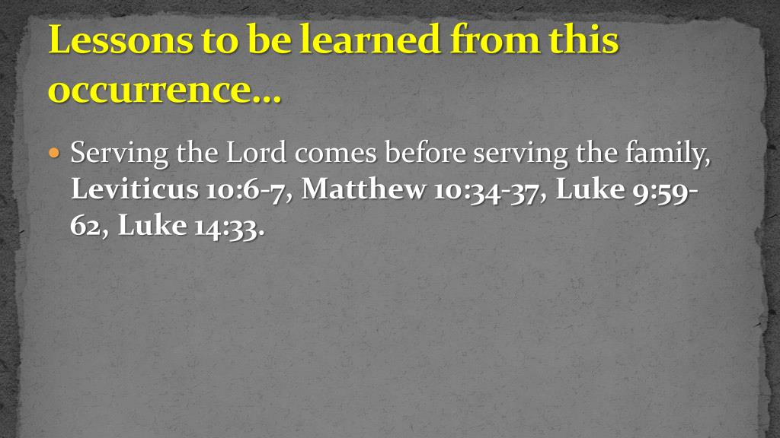
What does this mean for us?

Slide 9
Think on this . . .
How can we keep our hearts soft toward the Lord even when He brings suffering and loss into our lives?
Next Week’s Lesson
The Day of Atonement
Lev. 16:1-16

Slide 11


Slide 13



