Slide 1

A Humble Lord Is Born
December 26, 2021
“But [he] made himself of no reputation, and took upon him the form of a servant, and was made in the likeness of men” Philippians 2:7
Philippians 2:5-11; John 13:12-17

Slide 2

Introduction
Paul discovered there was no synagogue in Philippi.
Some Jewish women met regularly near the river on the Sabbath.
Paul was introduced to Lydia, a businesswoman who received Christ and was baptized.
Paul cast a demon out of a fortune teller which landed him and Silas in jail.
They were miraculously set free as a result of an earthquake.
In the process, the jailer and his whole family were converted to Christ.
A church was successfully planted in Philippi, and it remained faithful and steadfast in its ministry.

Slide 3


Slide 4

Today’s Aim
FACTS:
To know the humility of Christ in His birth , life, and death
PRINCIPLE:
To recognize Jesus as the ultimate example of humility and service
APPLICATION:
To put others’ interests above our own by humbly serving them as Jesus gives us an example

Slide 5
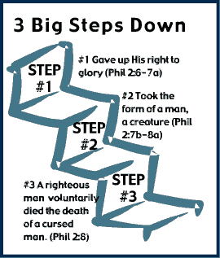
The Humiliation of Christ
Explain why our “mindset” is so important? (v. 5)
What was Paul saying in encouraging them to be of one accord? (v. 2)
How and why would people make themselves “of no reputation”? v. 7
Explain Christ’s greatest humilitation.
Philippians 2:5-8

Slide 6
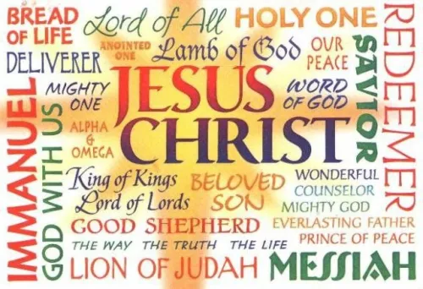
The Exaltation of Christ
How did God “exalt” Jesus? v. 9
In your own words, describe how Jesus is the “name above all names.” v. 9
Define “confess.” What does it mean to “confess that Jesus is Lord?” v.11
What is the ultimate goal of confessing Jesus Christ?
Philippians 9-11

Slide 7
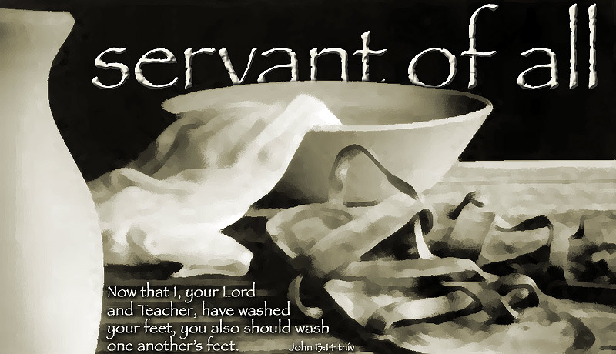
The Servanthood of Christ
Why did Jesus wash the disciples’ feet? v. 12
What principle did Jesus emphasize from foot washing? v. 15
What are some ways you have symbolically washed other people’s feet?
What is meant by true happiness in Jesus? v. 17
John 13:12-17

Slide 8

This Weeks Devotion
Read the scripture(s)
Write a prayer to make your request known to God
Record what the Holy Spirit reveals

Slide 9

Next Week’s Lesson
Explain how Jesus is the ONLY way to God.
The Way, The Truth, and The Life
John 14:1-11

Slide 10


