Slide 1
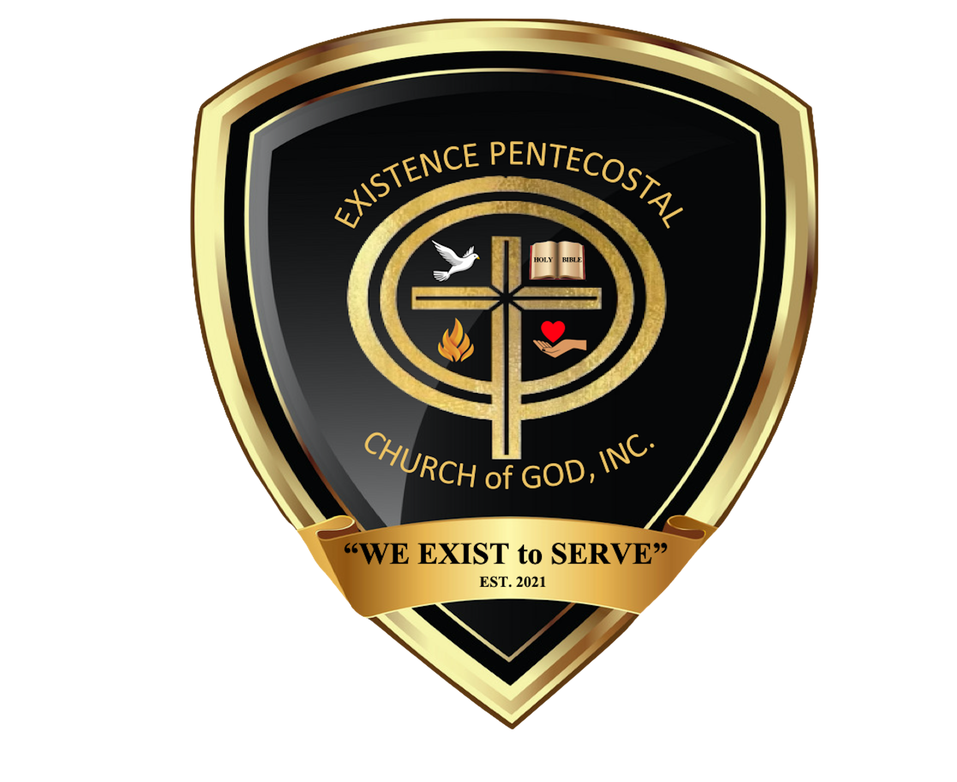

Slide 2

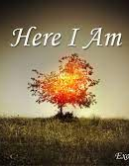
September 4, 2022
Obedience in Leadership
Exodus 3:1-12

Slide 3
Today’s Aim
FACTS:
To describe God’s unusual means of contacting Moses, His plan to deliver the Israelites from bondage, and the sign He gave Moses that the plan would succeed.
PRINCIPLE:
To show thata God employs human beings to carry out His sovereign will and assures them of the ability to carry out their assignment.
APPLICATION:
To help believers be open to God and what He wants them to do and be willing to rest on His promise to help them accomplish whatever He wants them to do.

Slide 4
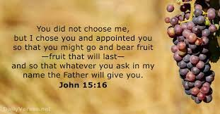
What do you think . . .
What three (3) things do this verse bring to your mind?

Slide 5
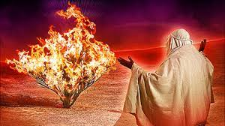
The Burning Bush – Ex. 3:1-3
Why did Moses need such an attention-getting sign in order for the Lord to address him? (vss. 1-2)
How has your life been changed by meaningful encounters with God?
God’s calling on our life is bigger than what we can see!

Slide 6

Holy Ground – Ex. 3:4-6
Why was the area around the burning bush considered holy ground?
If God is omnipresent what made the area around the burning bush holy ground?
What obstacles commonly prevent you from intentionally placing yourself in God’s presence?
To enter God’s presence requires a reverent acknowledgment on our part.

Slide 7
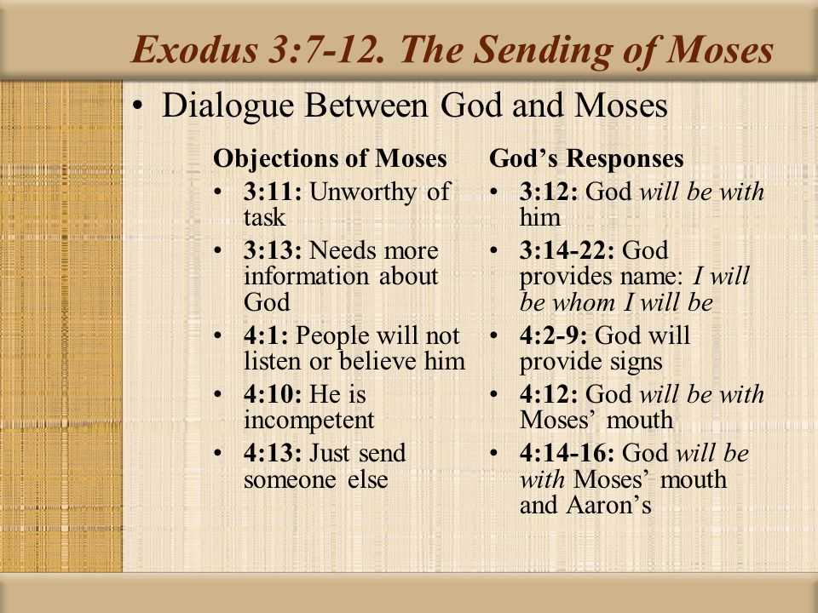

Slide 8
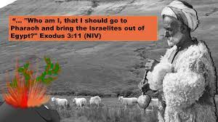
Israel’s Cry – Ex. 3:7-12
What comfort do you gain from vss. 7-9?
What did God call Moses to do? Why was this so daunting?
Why did Moses think he was so unqualified for the task (v. 11)? Was he right?
Notes:
The Mercy Seat wat the top or covering for the Ark of the Covenant. The Spirit of God dwelled between the two cherubim. God promises to :
Meet with them there
Instruct them there
Appear to them in a “cloud” there
Grant them mercy there
Mercy-seat—(Heb. kapporeth), a “covering;” LXX. and N.T., hilasterion; Vulg., propitiatorium), the covering or lid of the ark of the covenant (q.v.). It was of acacia wood, overlaid with gold, or perhaps rather a plate of solid gold, 2 1/2 cubits long and 1 1/2 broad (Ex. 25:17; 30:6; 31:7). It is compared to the throne of grace (Heb. 9:5; Eph. 2:6). The holy of holies is called the “place of the mercy-seat” (1 Chr. 28:11: Lev. 16:2).
Easton, M. G. (1893). In . New York: Harper & Brothers.
Easton, M. G. (1893). In Illustrated Bible Dictionary and Treasury of Biblical History, Biography, Geography, Doctrine, and Literature. New York: Harper & Brothers.
Inside the Ark of the Covenant were the two tablets of law, known as the Ten Commandments, which God gave to Moses, Aaron's rod which budded, and a jar of manna.

Slide 9
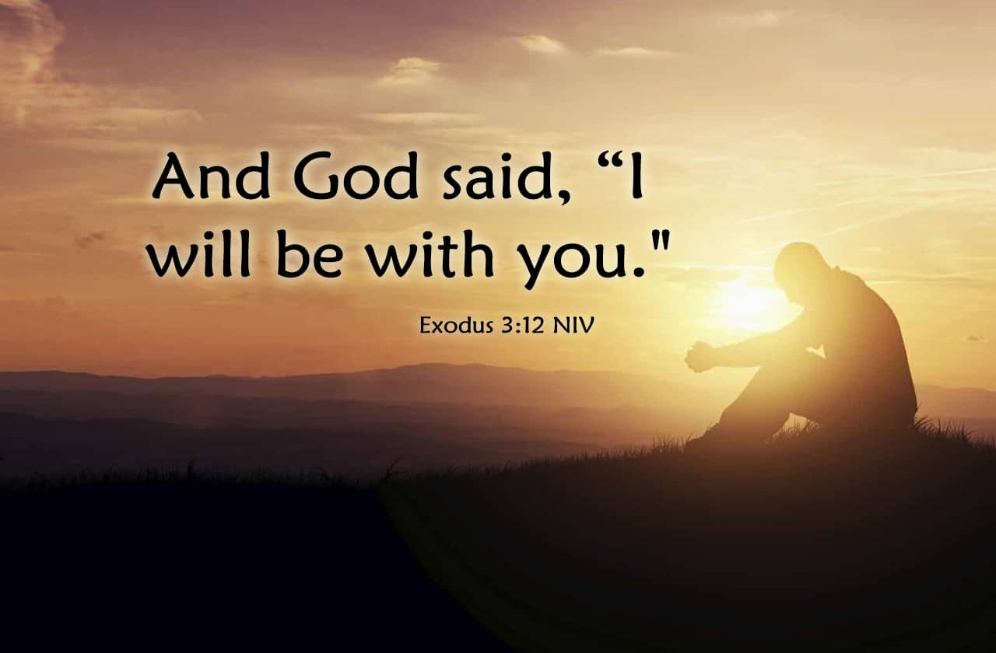

Slide 10
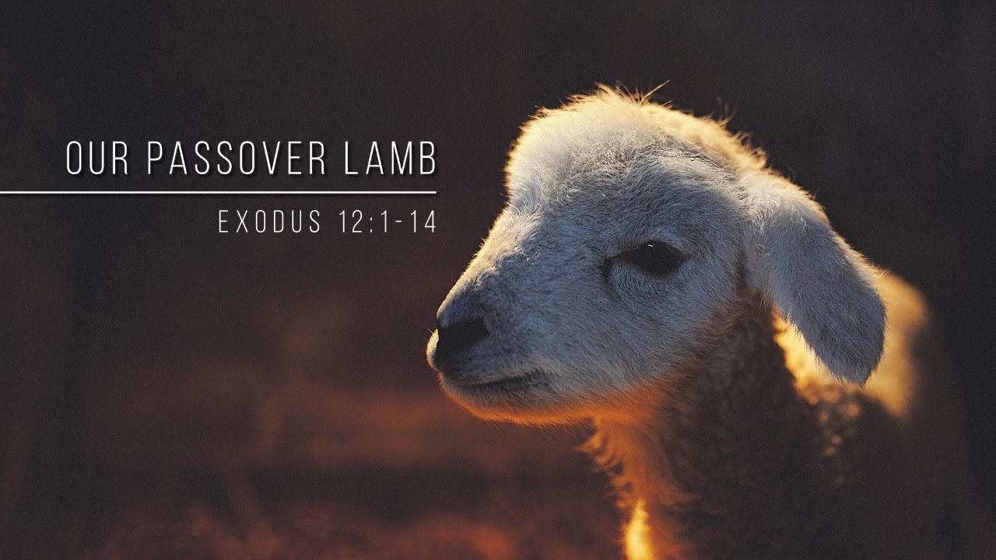
Next Week’s Lesson
Obedient to Remember
Exodus 12:1-14

Slide 12
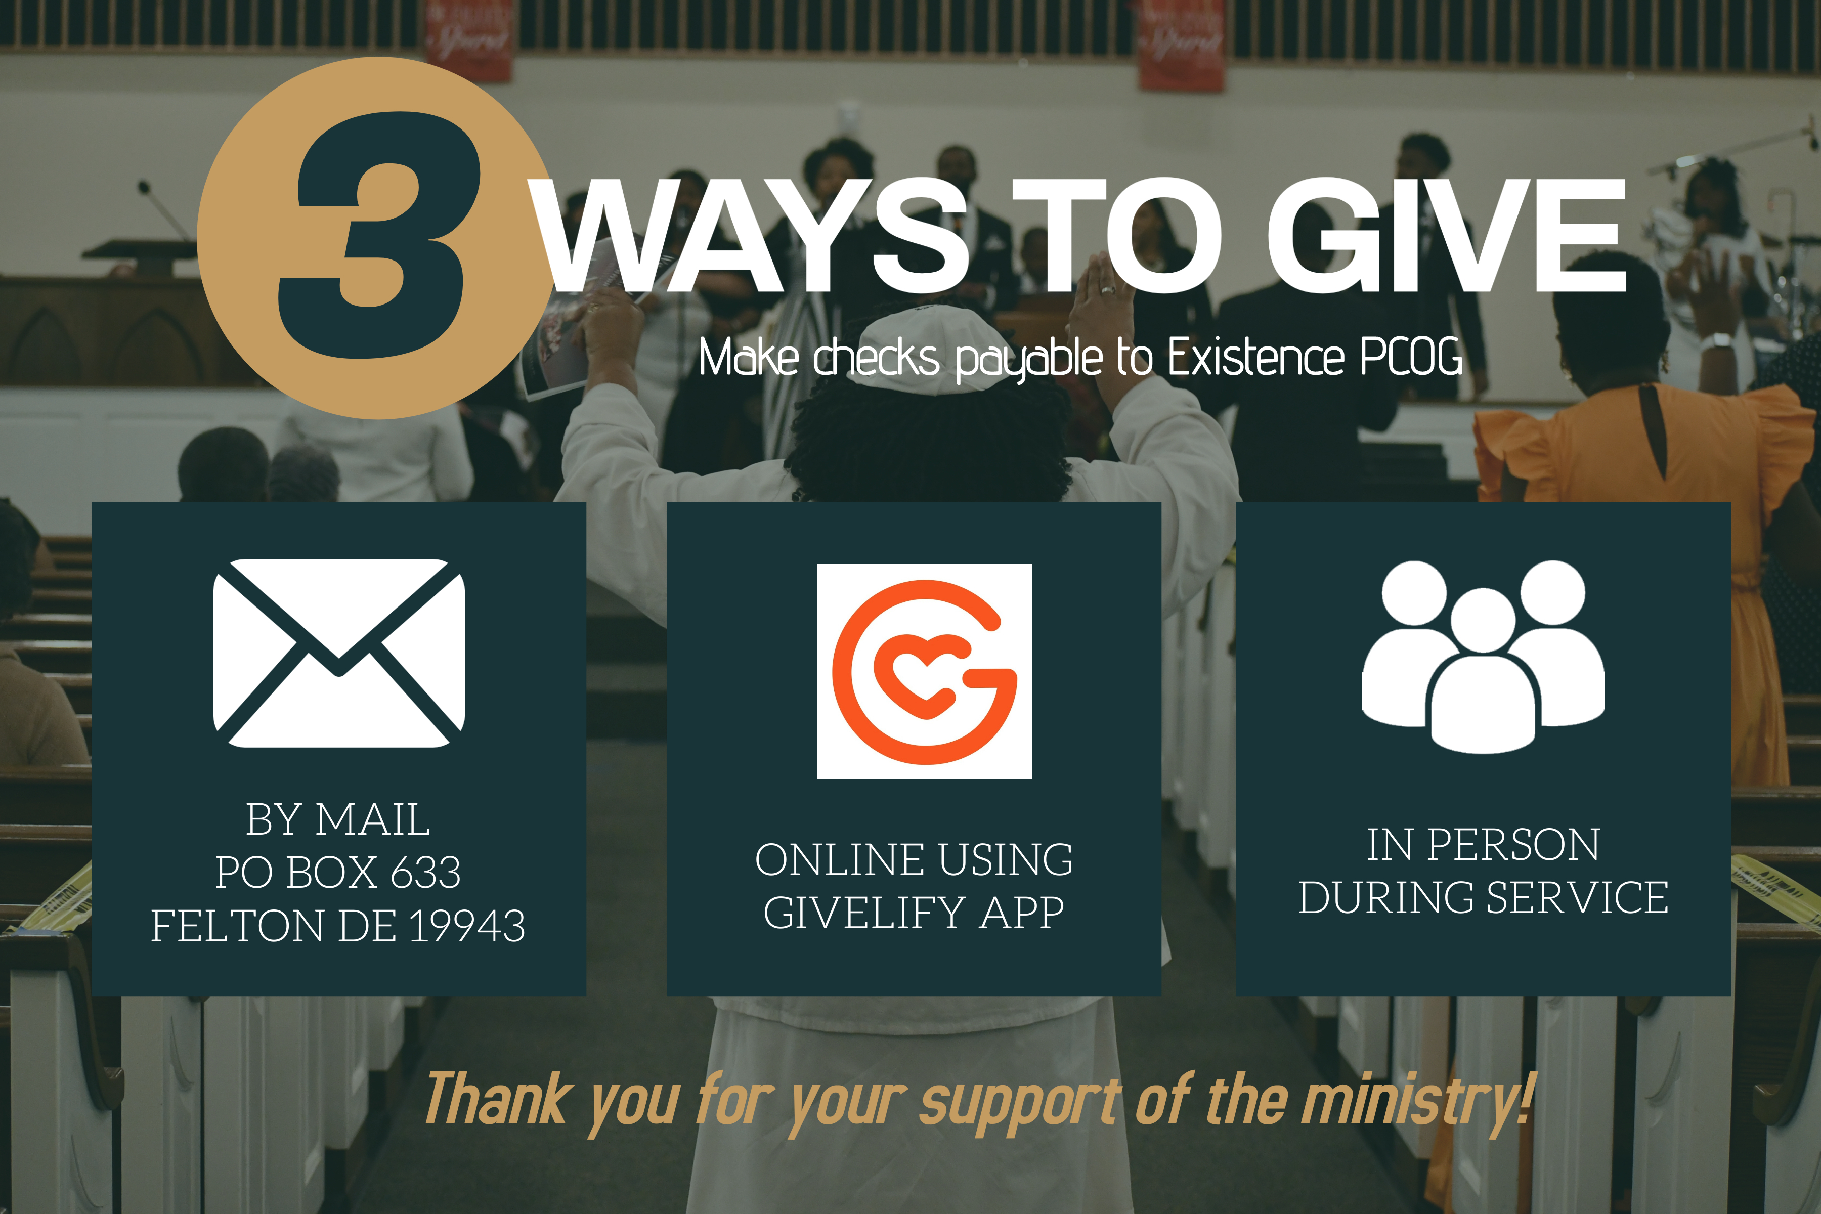

Slide 14
