Slide 1


Slide 2

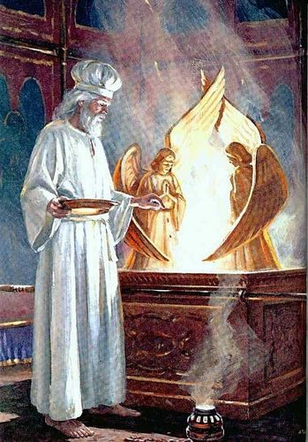
October 15, 2022
Obedience on the Day of Atonement
Leviticus 16:11-19

Slide 3
Today’s Aim
FACTS:
To see how and why atonement was made in the ritual described here.
PRINCIPLE:
To understand that atonement will help us understand the personality and thoughts of God.
APPLICATION:
To live daily with the understanding that our sins have been atoned for and are no longer held against those who trust in Christ.

Slide 4
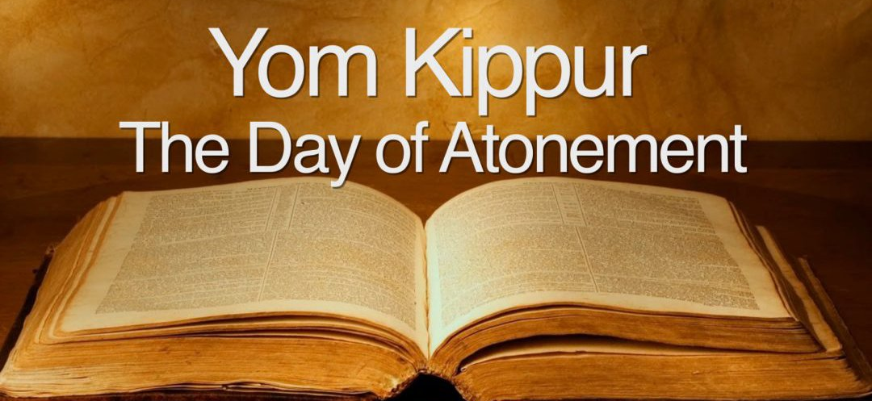
How did the Day of Atonement differ from Israel’s other feasts?

Slide 5
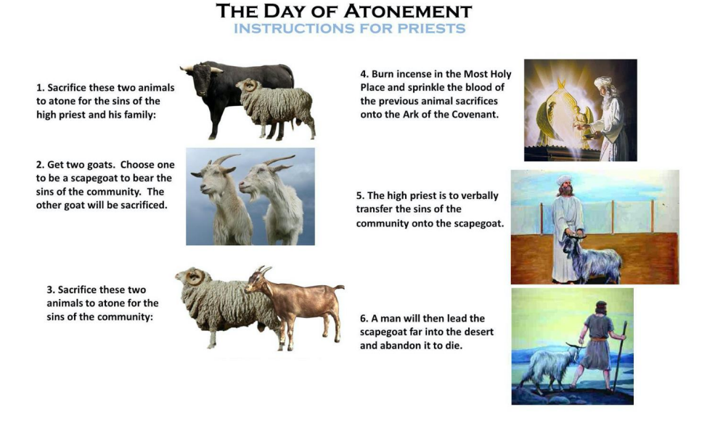

Slide 6
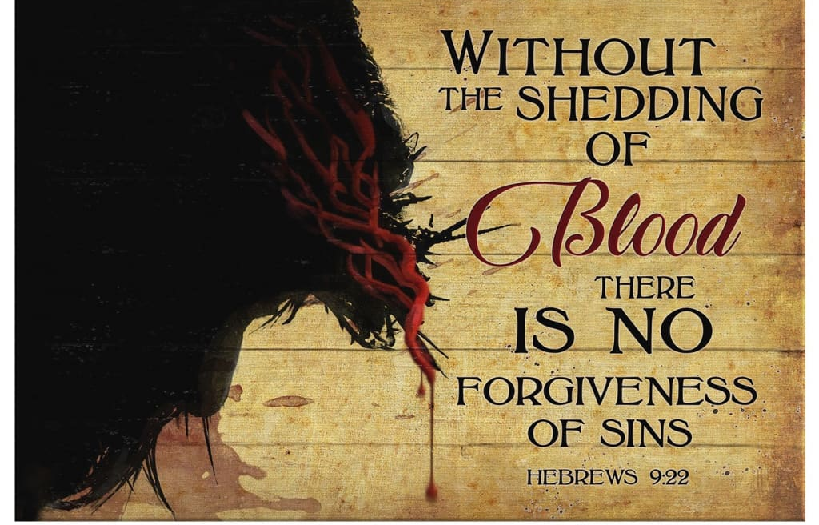

Slide 7
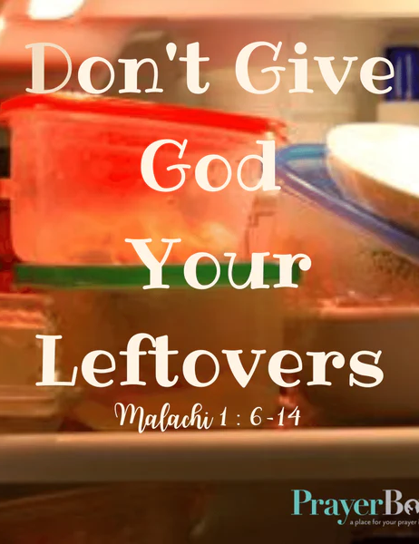
Next Week’s Lesson
Obedience in Offerings
Leviticus 22:17:25, 31-33

Slide 9
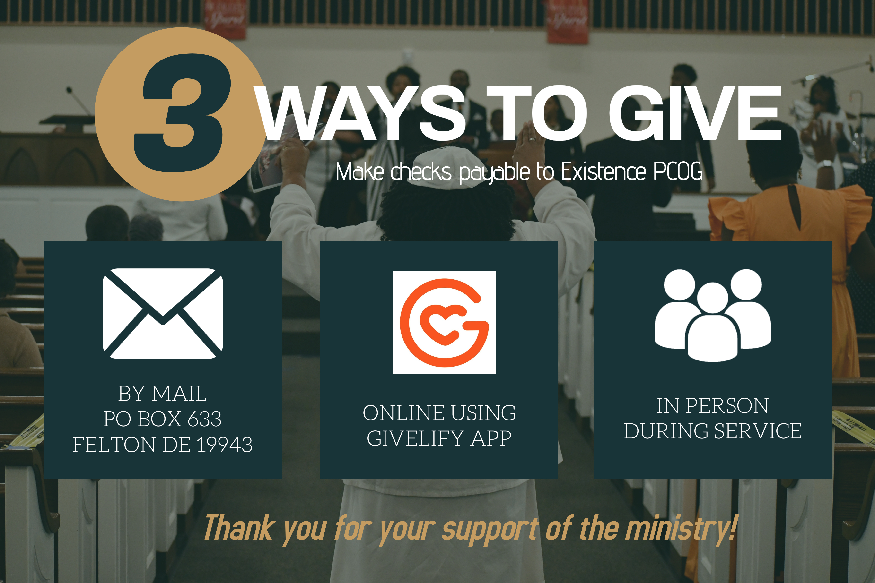

Slide 11



