Slide 1
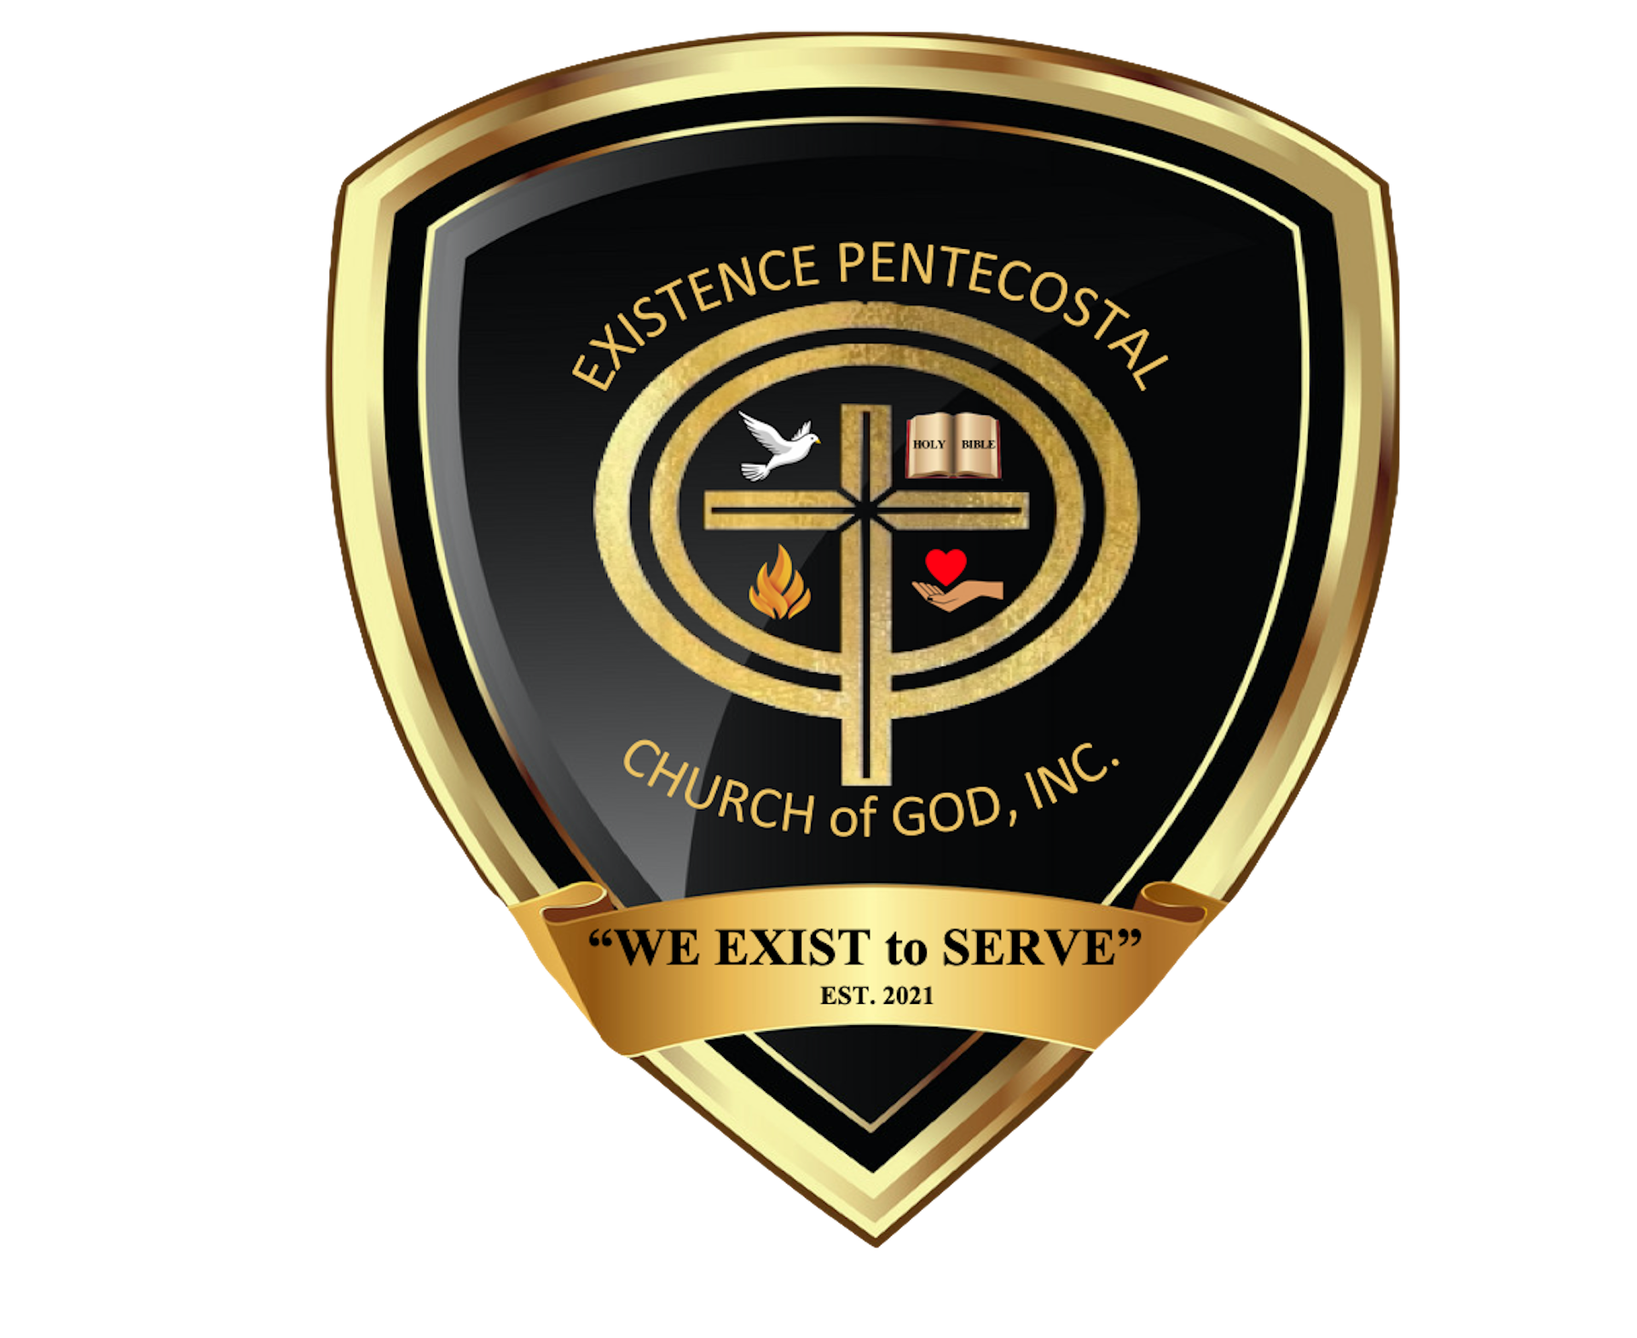

Slide 2

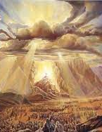
October 2, 2022
Obedience in Worshipping God Alone
Exodus 20:1-11

Slide 3
Today’s Aim
FACTS:
To study how God makes Himself known to His people through a covenant.
PRINCIPLE:
To show that our Gd is sa covenant-keeping God like no other.
APPLICATION:
To affirm that God gives us His rules for our blessing and always keeps His side of the bargain.

Slide 4
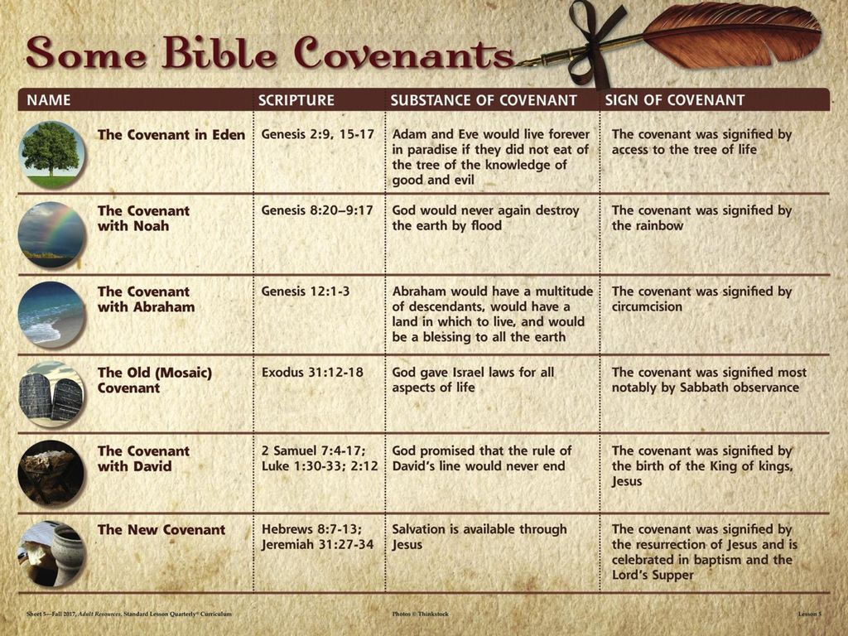
What do you think . . .
Read the phrase on your index card. On the back, write what comes to your mind.

Slide 5
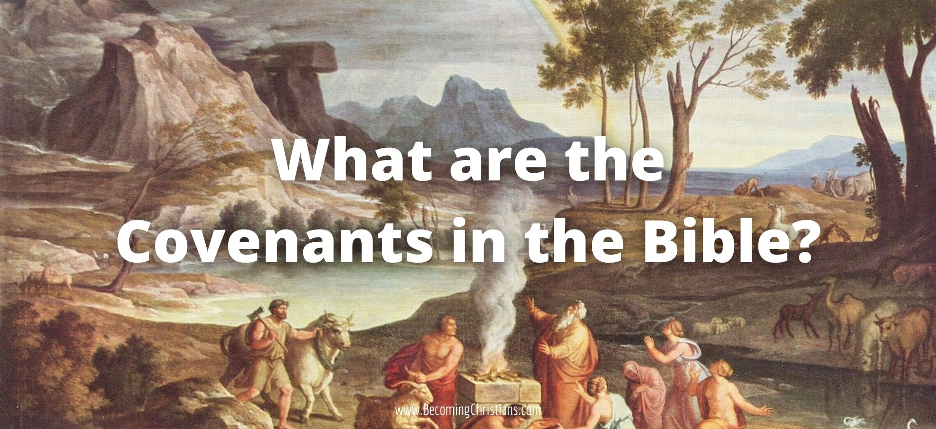
A contract or agreement between two parties.
Hebrew – berith (to cut, cutting)
Greek – diatheke (testament)
Covenant

Slide 6
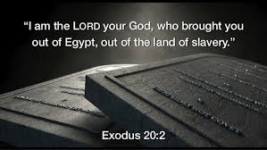
God of the covenant – Ex. 20:1-2
Finish this sentence . . . “I am the Lord your God, who . . .”

Slide 7
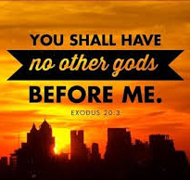
Terms of the Covenant – Ex. 20:3-7
What command did God give regarding worship?
Are there subtle ways Christians can put “other gods” before the Lord?
Why did God say they should make no images for their worship?
We distort God’s holiness when we replace God with representations of God.

Slide 8
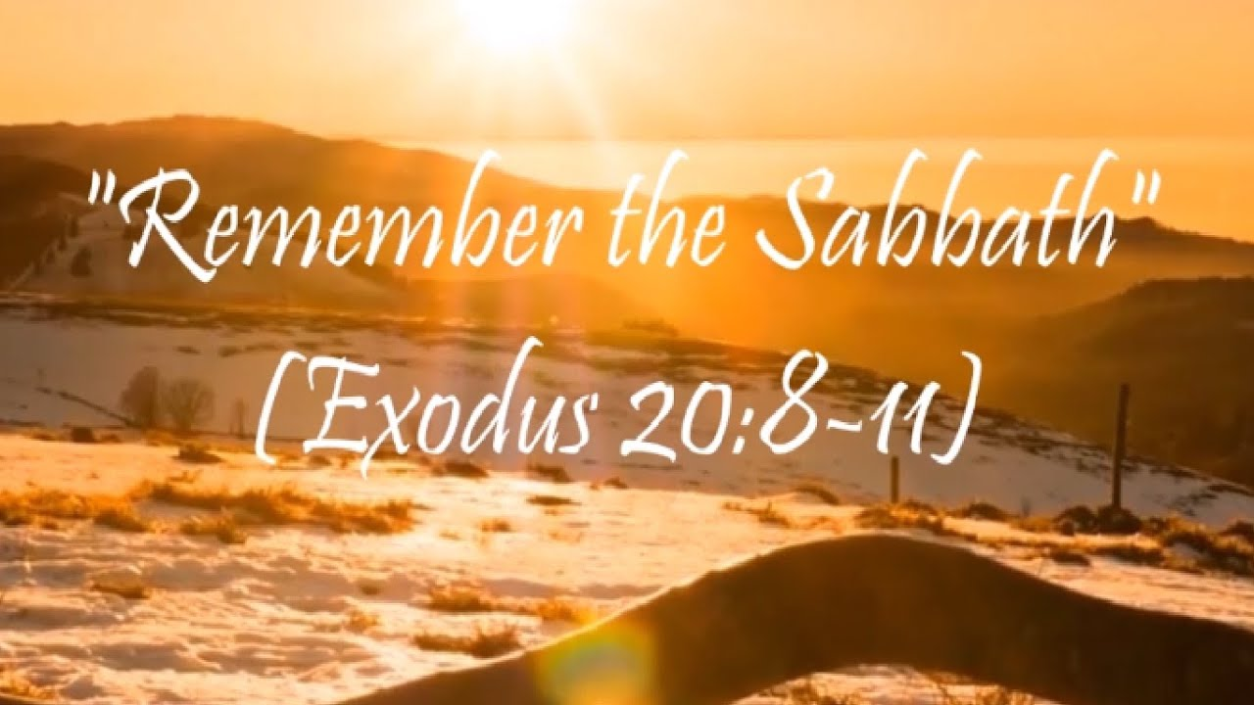
A Sign of the Covenant – Ex. 20:8-11
Why did God refer to the Sabbath as a day of rest?
With what did God connect His command to rest on the Sabbath?
How do the first four commandments protect our relationship with God?
Notes:
The Mercy Seat wat the top or covering for the Ark of the Covenant. The Spirit of God dwelled between the two cherubim. God promises to :
Meet with them there
Instruct them there
Appear to them in a “cloud” there
Grant them mercy there
Mercy-seat—(Heb. kapporeth), a “covering;” LXX. and N.T., hilasterion; Vulg., propitiatorium), the covering or lid of the ark of the covenant (q.v.). It was of acacia wood, overlaid with gold, or perhaps rather a plate of solid gold, 2 1/2 cubits long and 1 1/2 broad (Ex. 25:17; 30:6; 31:7). It is compared to the throne of grace (Heb. 9:5; Eph. 2:6). The holy of holies is called the “place of the mercy-seat” (1 Chr. 28:11: Lev. 16:2).
Easton, M. G. (1893). In . New York: Harper & Brothers.
Easton, M. G. (1893). In Illustrated Bible Dictionary and Treasury of Biblical History, Biography, Geography, Doctrine, and Literature. New York: Harper & Brothers.
Inside the Ark of the Covenant were the two tablets of law, known as the Ten Commandments, which God gave to Moses, Aaron's rod which budded, and a jar of manna.

Slide 9
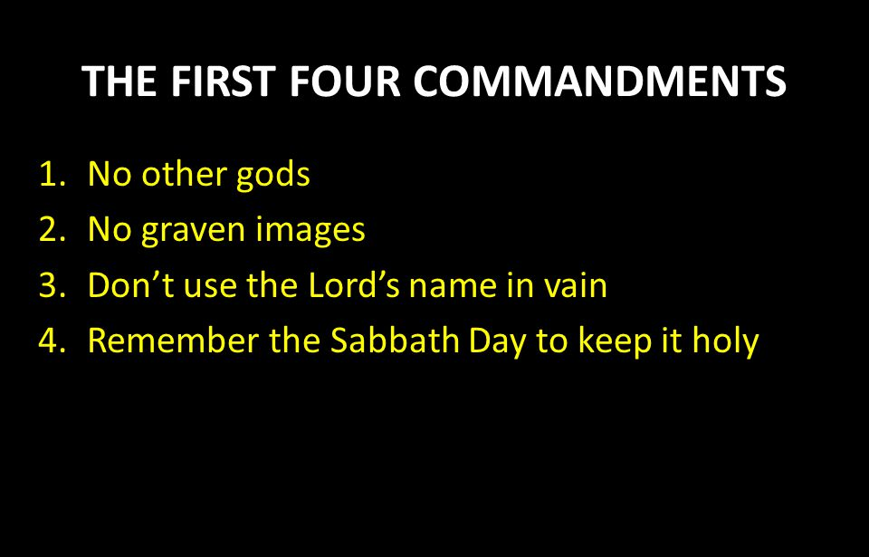

Slide 10

Next Week’s Lesson
Obedience in Building the Tabernacle
Exodus 40:16-21, 29-30, 34, 38

Slide 12
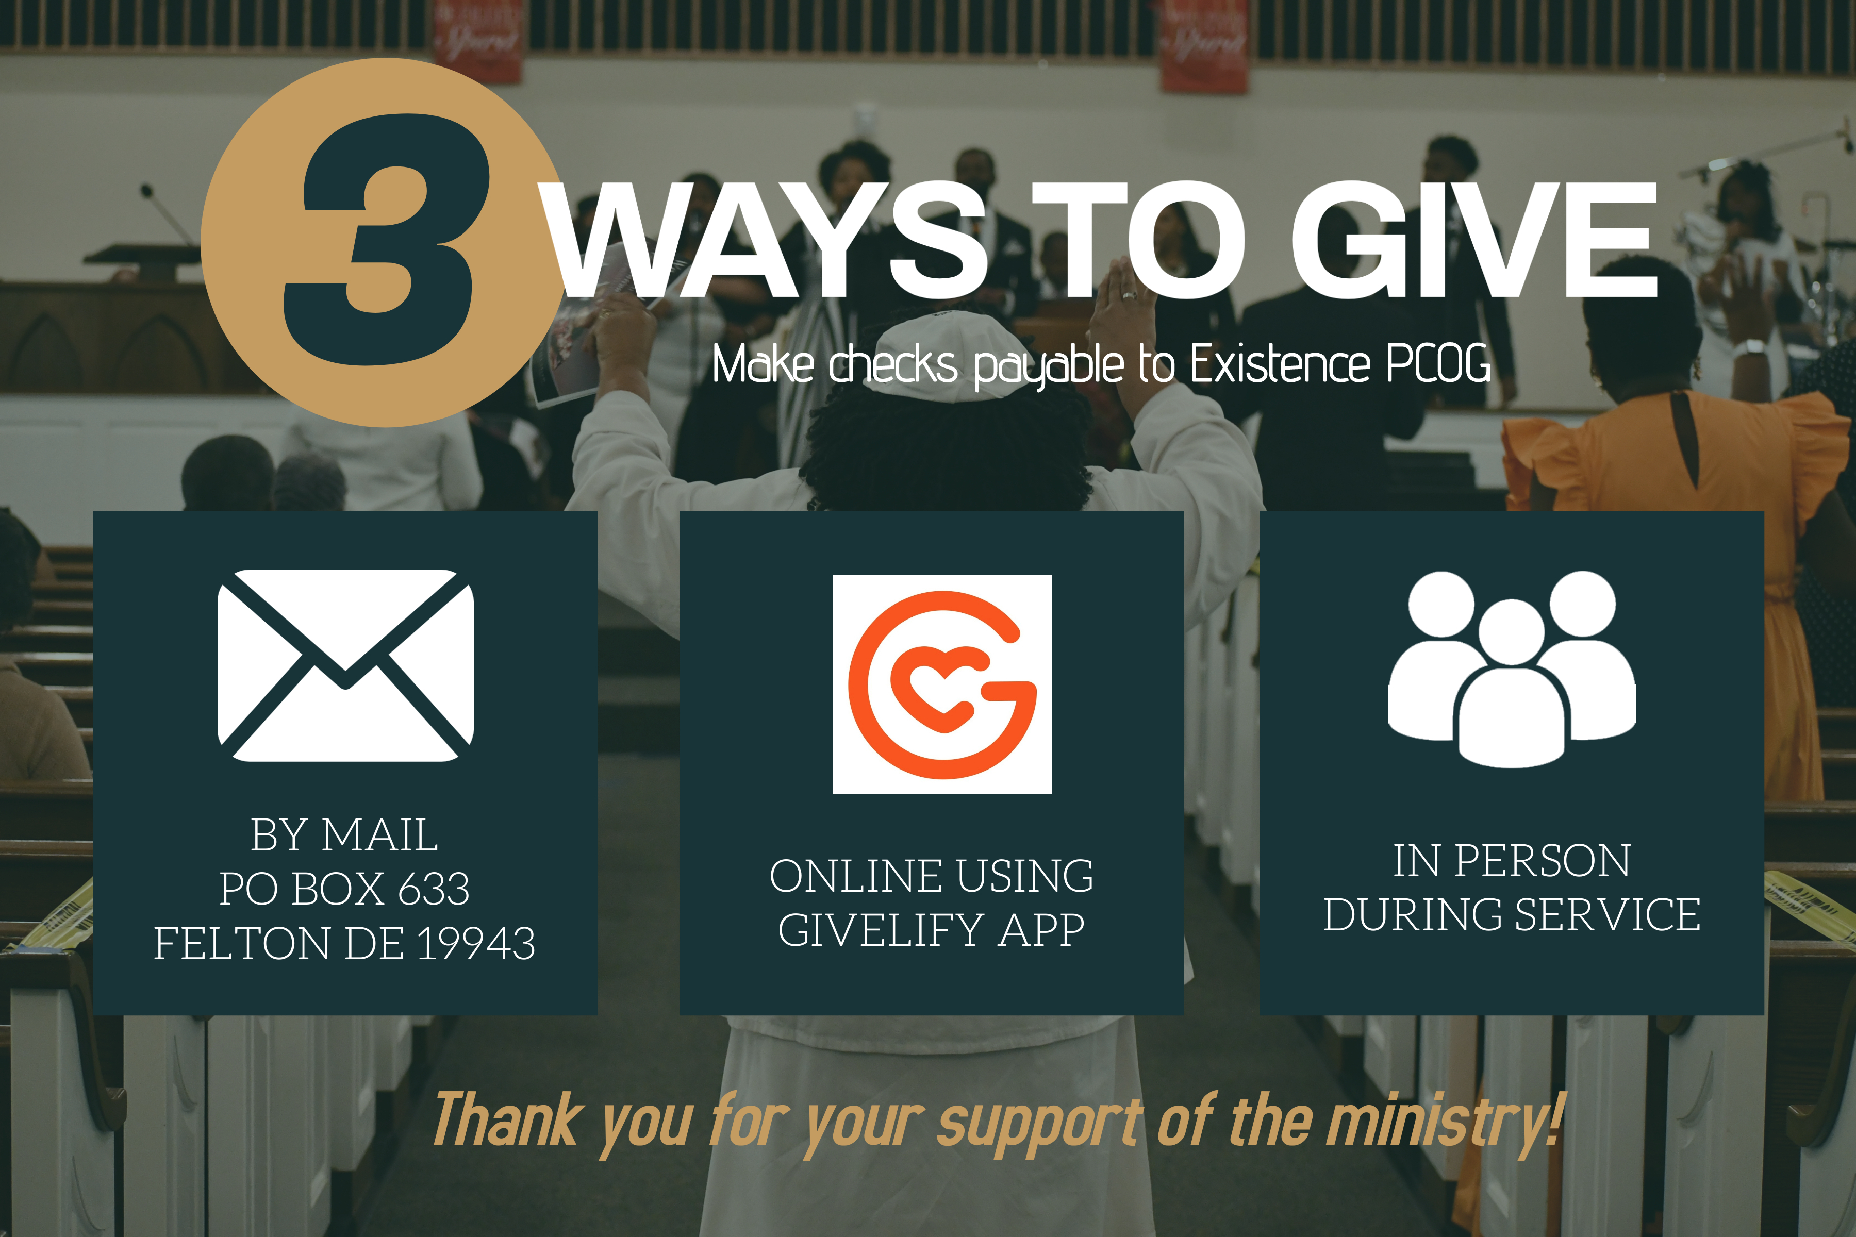

Slide 14
