Slide 1

Sunday school
Lesson 2
Obedient to Remember
September 11,2022

Slide 2
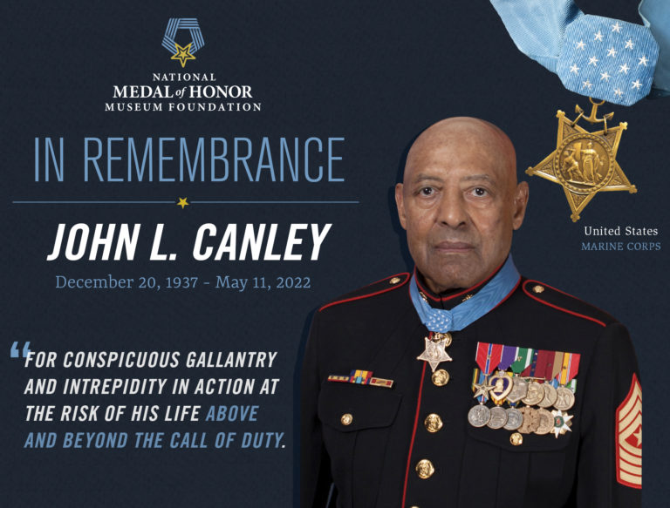

Slide 3
John Canley earned the Medal of Honor for actions between January 31 and February 6, 1968, while serving in the Vietnam War. With his passing this week at the age of 84, there are now only 64 living recipients of the nation’s highest award for valor in combat.
President and CEO of the National Medal of Honor Museum Foundation, Chris Cassidy, released the below statement:
“After his commanding officer was wounded, Canley took command of the company, just as the Marines entered Hue City. Canley led these Marines, often at great personal risk, through the brutal and unrelenting Battle of Hue City, repeatedly exposing himself to carry the wounded to safety. His actions saved the lives of over 20 Marines. That kind of unwavering bravery, courage and self-sacrifice is what the Medal of Honor represents. We owe it to John Canley – the Hero of Hue City – and every other Medal of Honor recipient who has gone to amazing lengths to defend our nation to share and preserve their stories for generations to come. We join his family, friends and all Americans in mourning this great loss.”
Canley enlisted in the Marine Corps in 1953 when he was only fifteen, using his brother’s paperwork to enter the service even though he was underage, and deployed three times to Vietnam. He retired from the Marine Corps in 1981 as a sergeant major.
John L. Canley Medal of Honor Action

Slide 4
WASHINGTON, D.C. --The Marine Corps announces the passing of Medal of Honor recipient retired Sgt. Maj. John L. Canley on May 11 after a decades long battle with cancer.
Sgt. Maj. Canley passed away in Bend, Oregon, with his family at his bedside.
Sgt. Maj. Canley was awarded the Medal of Honor in 2018 for his actions in 1968 during the battle Hue City, Vietnam. While serving as the company gunnery sergeant for Alpha Company, 1st Battalion, 1st Marine Regiment, Sgt
Sgt. Maj. Canley’s legacy will live on through the USS John L. Canley currently preparing for its christening scheduled for June 25 in San Diego. The ship is a 90,000-ton expeditionary sea-base and will be forward deployed in the Western Pacific.
Sgt. Maj. Canley will be buried with full military honors at the Arlington National Cemetery at a later date to be determined.

Slide 5
Lesson 2
Prior to Exodus 12, nine plagues hit Egypt and tenth is about to take place. DEATH. This final plague would cause death to the first born of everything in the land of Egypt, from man to beast.
When God told Moses about the final plague, he was also told how Pharoah would release the children of Israel and the people needed to by ready.
What comes next is that preparation.

Slide 6

Passover preparation
Exodus 12:1-3
Going to Pharaoh and the people, “ getting the word out.”
The Passover month
Was the Passover a surprise to Pharaoh?

Slide 7
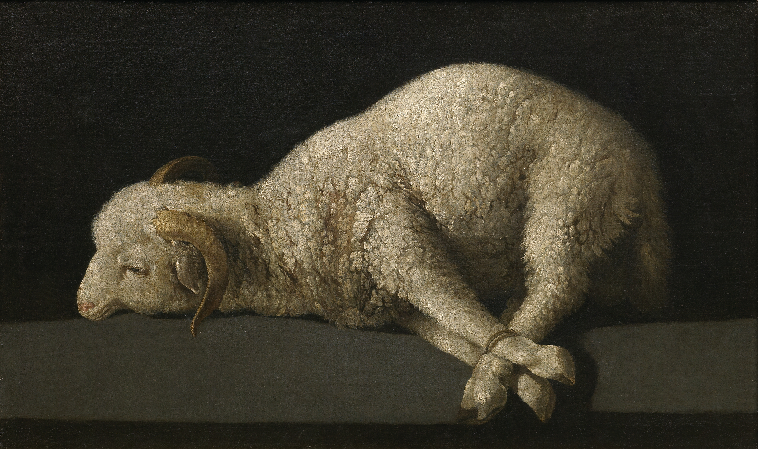
The Lamb
Exodus 12:4-6
This was a “ Family Affair”
The Lamb is for “great and small”
Can you find a lamb or goat, “ without spot?”

Slide 8
The Blood
Exodus12:7-11
What does the Blood mean?
What is purtenance?
Are you ready to move?
The Blood SAVES, SAVES, SAVES!!!!!

Slide 9

The Memorial

